Slide 1

Temperature and humidity monitor
Final Project of Computing Principle of Mobile Embedded Systems
Fall 2019

Slide 2
Team members （ContACT INFO HIDEN FOR PRIVACY)
Miao Yin
Jin Xu
Donglin Gao
Linzhang Wu
Undergraduate student in ECE department
lw568@scarletmail.rutgers.edu

Slide 3
guideline
Objective
Approaches
Result
Challenges & Limitations
Future works

Slide 4
Objectives
This project aims to monitor the abnormal temperature and humidity of a certain area(e.g. inside the machine or space where needs to dry and confined)
Industry automation monitor(e.g. Soy Sauce industry)
SmartHome monitoring

Slide 5
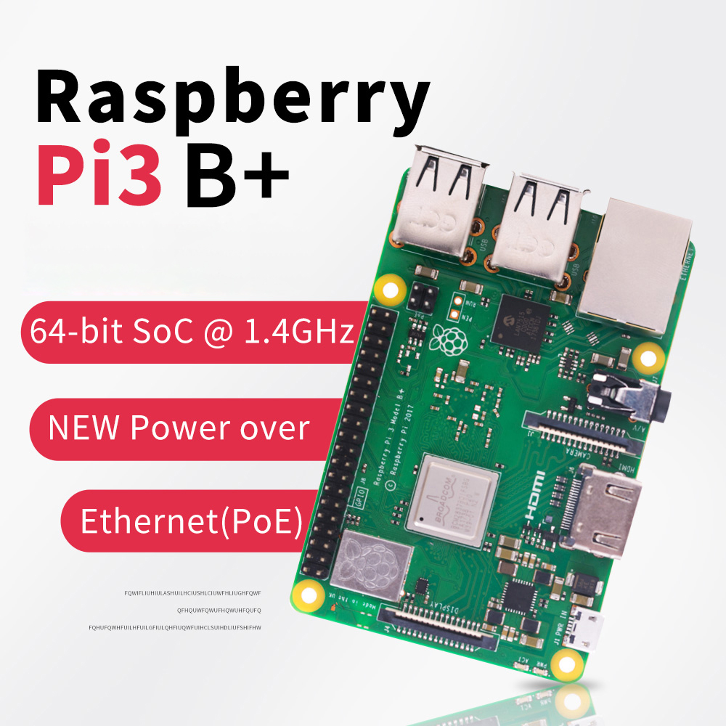
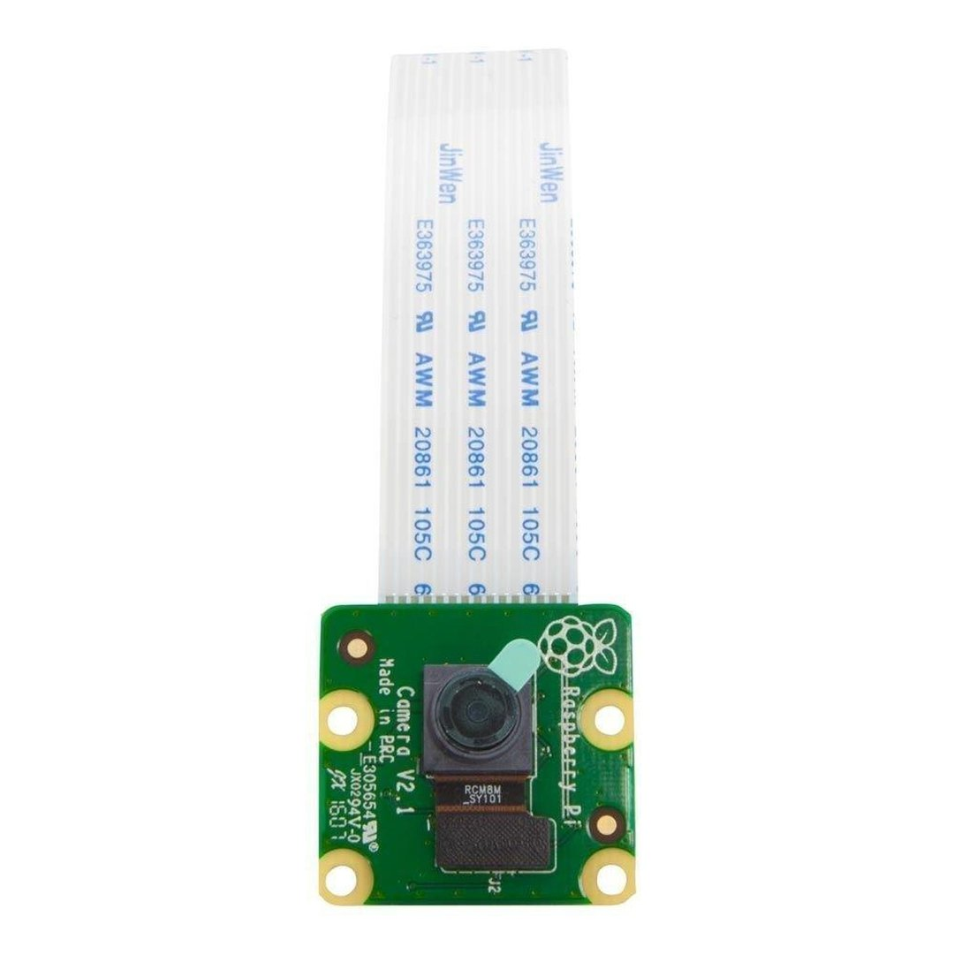
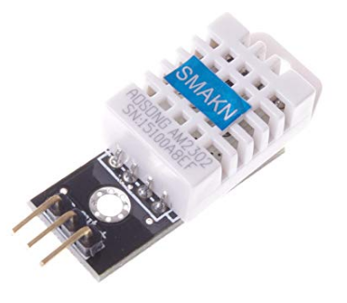
Approaches -- Sensors and hardware
Raspberry pi 3b+
Raspberry pi mini camera v2.1
Temperature and humidity sensor
Bluetooth enabled
32 GB SD card
Maximum of 1080P30 and 8MP Stills in Raspberry Pi Board
Sensor Model: AM2302
Signal output: digital

Slide 6
APPROACHES – TEMPERATURE AND HUMIDITY SENSOR
Low cost
A capacitive humidity sensor and a thermistor to measure the surrounding air
Temperature measurement range: -40 ℃ --80 ℃ with ±0.5°C accuracy
Humidity measuring range: 0--100% RH with 2-5% accuracy

Slide 7



Approaches – bluetooth control and transmittion

Slide 8


Slide 9
Approaches -- the work function of pi
Place the Raspberry Pi in the position to be monitored
The Pi continuously reads the temperature and humidity every 15 second(editable)
Once an abnormal reading, either temperature or humidity, is detected(larger than the threshold), the readings and a photo will be recorded then stored in the Pi

Slide 10
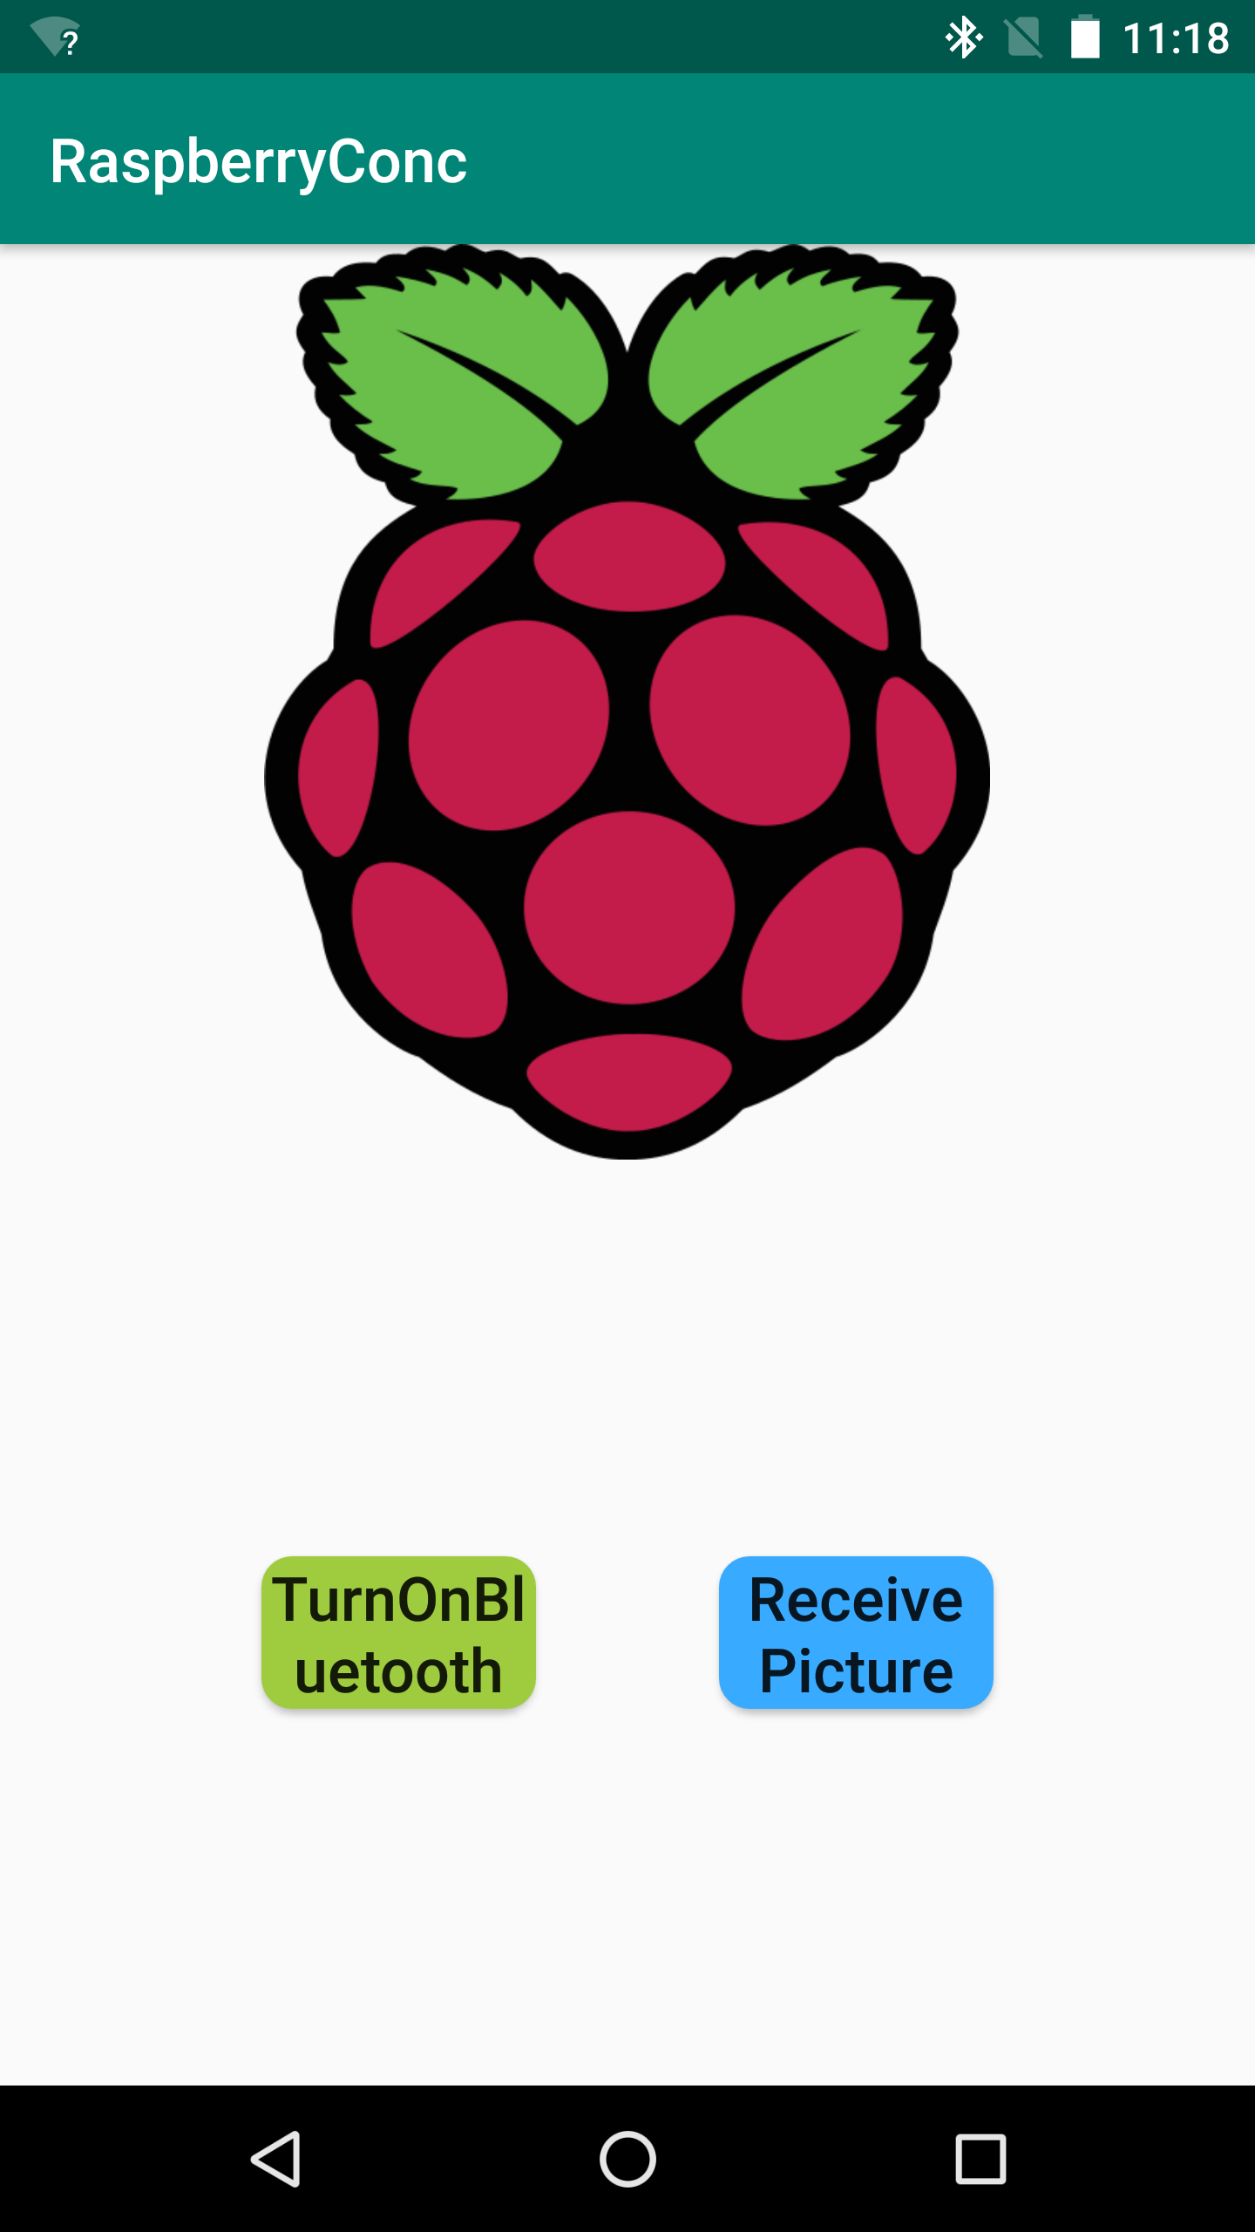
Approaches – work function of phone
Open the designed app in the Android phone.
Using the button 'TurnOnBluetooth' to Turn on Bluetooth on your phone to pair with Raspberry Pi's Bluetooth.
Using the button 'Receive Picture' to get the picture saved in Pi.

Slide 11
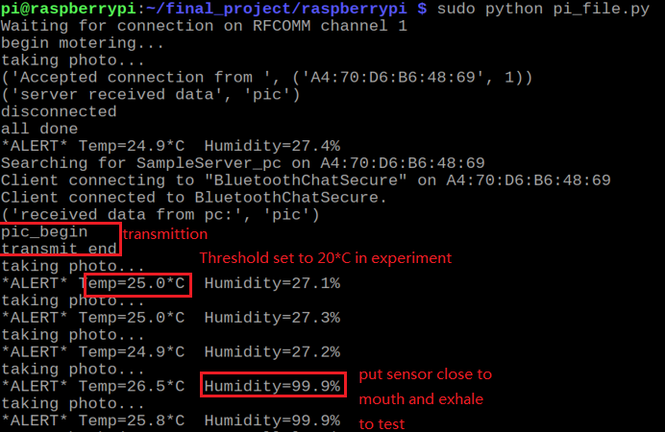
Running codes in Pi
The ground truth is obtained from a thermometer. The room temperature is 25.0˚C. The accuracy is within 0.2 ˚C
We are 98% confident about the temperature sensor reading
We tested humidity sensor with a moist environment and get positive result. In future work, a humidity monitor can be used during the experiments.

Slide 12
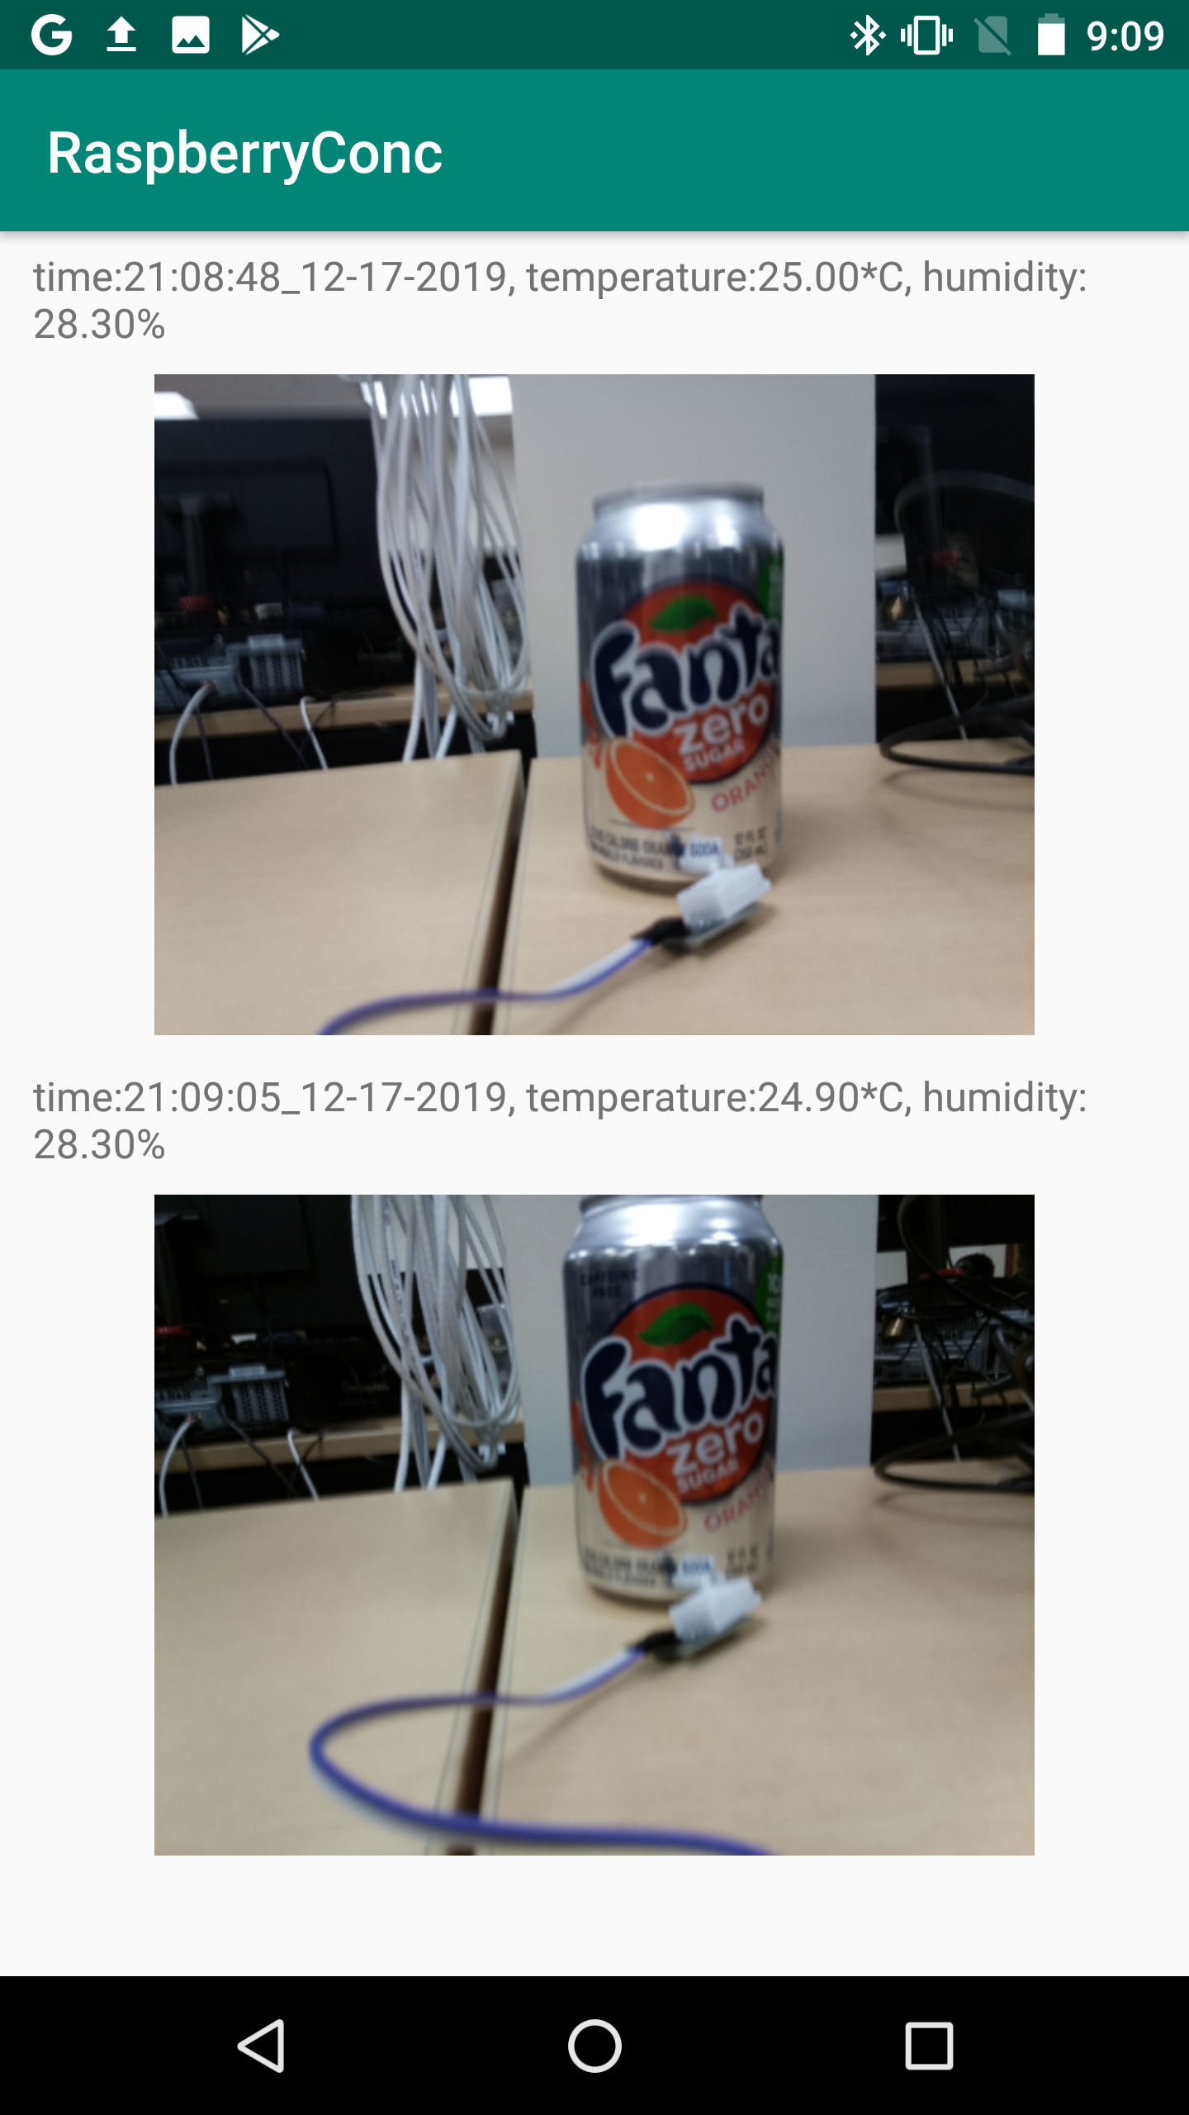
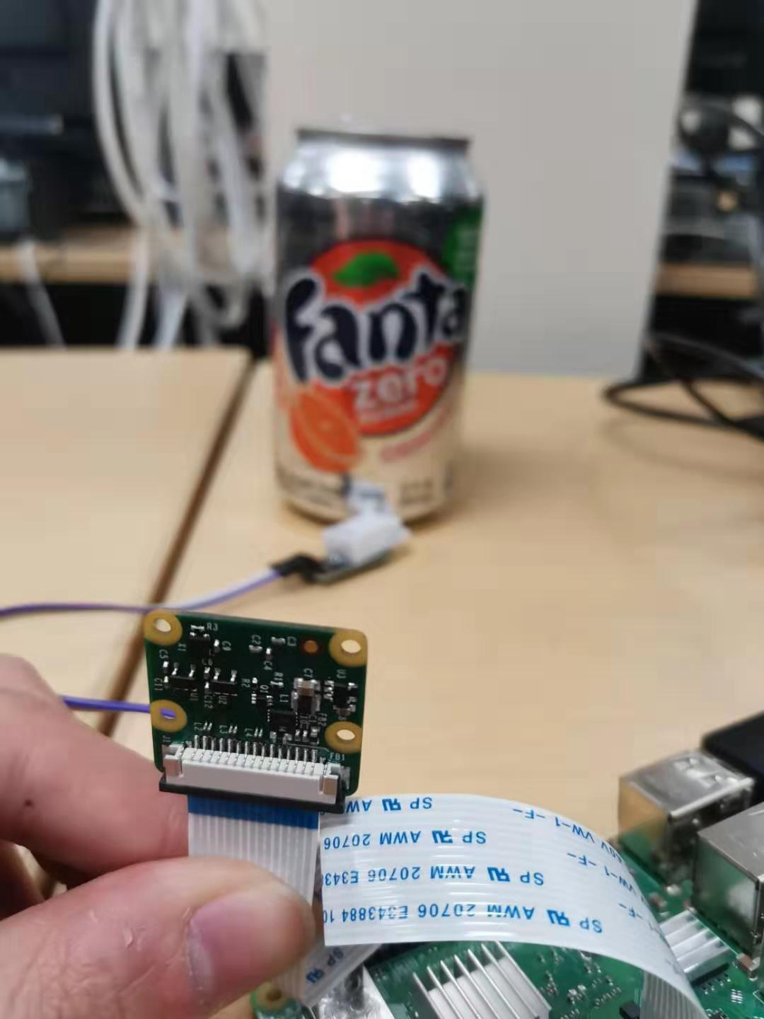
Result

Slide 13
Challenges limitation future work

Slide 14
Challenges & limitation
1. Due to the limits of our Raspberry pi's buffer size, our speed of transmitting picture is low (15s)
2. Range of receiving the picture is a bit small as it relies on Bluetooth network.
3. The system lacks data collation ability.

Slide 15
Future works
1. The framework of the monitor has already been built, with different sensors, we can set the monitor into different areas to achieve different.
2. To provide faster transmitting speed, we can use wifi network in future.
3. App refinement and Upgrade for Pi

Slide 16
Team member contribution
Miao Yin: Coding for bluetooth communication and information record in raspberry pi
Jin Xu: coding for android and raspberry pi
Donglin Gao: System Testing, Powerpoint slides
Linzhang Wu: Sensor purchasing, Camera testing, Powerpoint slides

